Slide 1



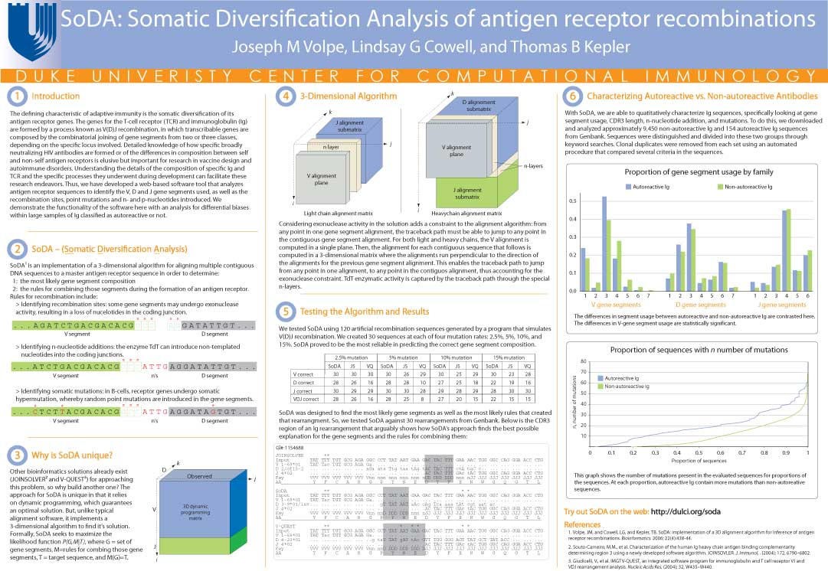


Tetranucleotide usage in mycobacteriophage genomes: alignment-free methods to cluster phage and infer evolutionary relationships Chen Ye, Benjamin Siranosian, Emma Herold, Minjae Kwon, Sudheesha Perera, Edward Williams, Sarah Taylor, Christopher deGraffenried
BROWN UNIVERSITY PHAGE HUNTERS
1
Alignment-free analysis
3
Phylogenetic Trees
Conclusions
4
Exceptional 4-mers
2
Methods
5
Genomic self-similarity
Some homology
Evidence of horizontal gene transfer?
JoeDirt gp 130
Mycobacterium abscessus E = 2e-48
Flavobacterium psychrophilum E=2e-28
Streptomyces sp. E = 4e-28
Opitutaceae bacterium TAV1 ATPase E = 1e-23
JoeDirt gp 131
Kmer counting
Tetranucleotide usage deviation
Tetranucleotide Difference Index
Investigate with
Phamerator
BLAST
Future Directions
Acknowledgements
We are grateful to Dr. David Warren, Dr. Peter Shank, Dr. Jason Sello, Ms Sarah Taylor, Kohana Leuba, Nick Sinnott-Armstrong, HHMI’s SEA program and the University of Pittsburgh.
More likely:
Cluster L genomes are very repetitive at the end.

